Slide 1
Treating Depression:
New Medicines Service
Kiran Hewitt
18th September 2025

Slide 2
Content
Introduction to your local MH Trust and Pharmacy Team
  who are we?
  what do we do?
Therapeutic guidance on treatment with AD’s
Practical considerations to support conversations and delivery of NMS

Slide 3
Contacts & Resources (1)
Pharmacy Team Office: 01522 421568 lpft.pharmacy@nhs.net
CMHT contact details - ?
Choice and Medication website available via http://www.choiceandmedication.org/lpft/
CPPE Depression: having meaningful conversations – a focal point
CMHP – College of Mental Health Pharmacy
Psych I, 2, Psych Techs courses https://www.cmhp.org.uk/

Slide 4
Contacts & Resources (2)
Post graduate Psychiatric Pharmacy certificate & diploma
  - Aston University
Education pack to support appropriate prescribing of antidepressants
  - Developed by CRG, system improvement project
LPFT prescribing guidelines
CMHT bases across the county – contact details to follow

Slide 5
Case Study
Mr C, 80 years old gentleman
First hospital admission 2 days ago
Recent history of not sleeping well, getting agitated at night, waking up early in the morning
Stopped cooking for himself about 1 year ago, eats out or take aways, sometimes doesn’t bother
For past 2 months, won’t drive his car
Lost interest in TV programmes, reading the newspaper, current affairs, gardening, meeting friends
Now worrying about everything, asked GP for help

Slide 6
Mr C’s Medicines O/A
Amitriptyline 20mg at night
Citalopram 10mg at night
Perindopril 2mg in the morning
Metformin 500mg tds
Gliclazide 40mg bd
Diazepam 2mg tds
What would you query, why?
Notes:
Will leave you to think about Mr C, and we’ll revisit him later…..

Slide 7
LPFT
Adult mental health
  Inpatient wards (x15), forensic, PICU, rehab, PCDU, UAC
Adult community mental health teams (CMHT/LMHT)
  Crisis and resolution home treatment teams (CRHTT)
  Perinatal mental health
  Psychiatric liaison service / Psychological treatment service
  Early Intervention Psychosis (EIP)
Specialist Services
  Children and Adolescent (CAMHS) – under 18’s, Eating disorders
  ADHD & ASD
  Learning Disabilities (LD)
Older Adults
  Dementia and functional illnesses
Route/access to services – several
Multidisciplinary - beyond HCPs to criminal justice, police, education, families, carers, social services

Slide 8
LPFT Pharmacy Team
14 pharmacists, 11 medicines management technicians, I MH nurse, 3 pharmacy support workers, 2 admin, 4 PTPT, 2 FTPs
Mental health expertise, specialising in the use of medicines used to treat mental illness
Mainly patient-facing, clinical roles, alongside consultant psychiatrists and the MDT – inpatients and community teams
  Meds reviews up to highly complex, advice on most appropriate treatments for individuals
  patient and carer education and counselling to empower and improve adherence
  ensuring safe and secure handling of medicines
  clinical governance, policy development
  Medicines Information provision
  Essential and ad hoc E&T for other HCPs
  Legal consultations and compliance

Slide 9
Important considerations
We must advocate the appropriate use of medicines in mental health because:
  Medicines are the mainstay of treatment for most mental illnesses.
  Mental health drug trials are not as robust as general medicines.
  There aren’t many pharmacists c/w other professions.
  We can only improve the wider picture through other people rather than doing it all directly ourselves – and working together
  Our role should be to support and educate people and provide options/choice – SDM.
  Many mental health staff work in isolation in the community and have little formal training on psychotropic medicines.
  Guidelines are fine, but only really cover about 80% people - the ones we see in secondary care are often in the other 20%.

Slide 10
Depression
Depression is common but often undetected by the medical profession.
Only about ½ of individuals with major depression are identified by their GP
  the other ½ are undiagnosed/misdiagnosed
Under use of validated screening and assessment tools to help diagnose
Patient Health Questionnaire
http://www.phqscreeners.com/sites/g/files/g10016261/f/201412/PHQ-9_English.pdf
Beck's Depression Inventory
http://www.hr.ucdavis.edu/asap/pdf_files/Beck_Depression_Inventory.pdf
Hamilton Depression Rating Scale
http://healthnet.umassmed.edu/mhealth/HAMD.pdf

Slide 11
Symptoms - overview
At least 5 symptoms each day for at least 2 weeks -
Low mood
Anhedonia
  Core symptoms
Plus weight changes, irritability, sleep disturbance, EMW, psychomotor agitation, retardation, loss of energy, fatigue, recurrent thoughts of death, suicidal ideation

Slide 12
The Aim of Treatment
Effective treatment for depression should return the person to their premorbid state
Residual symptoms are predictors of:
  functional impairment
  relapse
  suicide

Slide 13
Stepped-Care Model (NG90)
Focus of the Intervention | Nature of the Intervention
Step 4: Severe and complex depression; risk to life; severe self-neglect | Medication, high-intensity psychological interventions, electroconvulsive therapy, crisis service, combined treatments, multi-professional and inpatient care
Step 3: Persistent subthreshold depressive symptoms or mild to moderate depression with inadequate response to initial interventions; moderate and severe depression | Medication, high-intensity psychological interventions, combined treatments, collaborative care and referral for further assessment and interventions
Step 2: Persistent subthreshold depressive symptoms; mild to moderate depression | Low-intensity psychological and psychosocial interventions, medication and referral for further assessment and interventions
Step 1: All known and suspected presentations of depression | Assessment, support, psychoeducation, active monitoring and referral for further assessment and interventions

Slide 14
Treatment can be divided into three phases:
Acute
Continuation
Prophylaxis

Slide 15
Acute phase
About ¾ of people diagnosed with depression will respond to treatment with an antidepressant
  providing a minimum effective dose (optimised for that individual)
  maintained for an adequate period of time.

Slide 16
Continuation phase
Following remission in the acute phase of treatment, the antidepressant should be continued at the effective dose for at least a further six months.
This reduces the risk of recurrence, and the risk is even less if treatment continues for a year.

Slide 17
Prophylactic phase
If a person has a history of recurrent episodes, treatment should continue after the continuation phase. The aim of this is to prevent another episode occurring in the future.

Slide 18
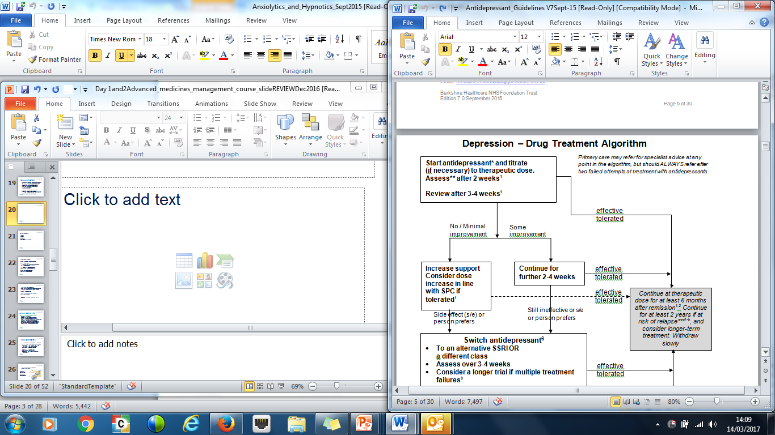

Slide 19
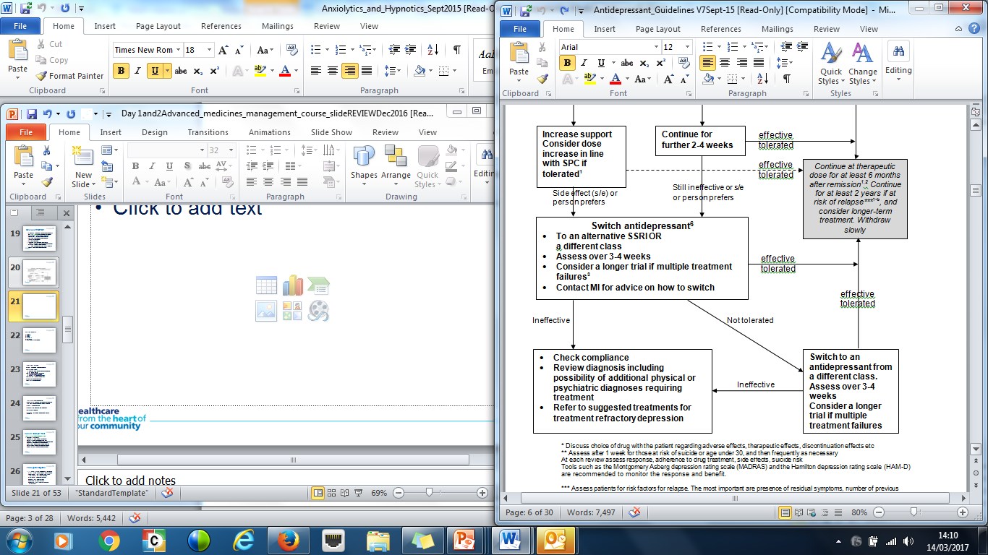

Slide 20
Antidepressants
Not recommended for mild depression
Primary care may refer for specialist advice at any point in the algorithm, but should always refer after two failed attempts at treatment with antidepressants
Start low, go slow – monitor closely for first 2 weeks. Suicide risk?
Optimise the dose
If some response, continue longer
Check compliance and tolerability

Slide 21
Antidepressant Choice
Consider factors affecting choice
  contact and conversations longer term
  co-morbidities
Avoid non-evidence based combinations
  possibly burdensome, costly, exacerbation of other issues problems and risk of serotonin syndrome
3 or more ADs seen in practice…..

Slide 22
Choice of treatment
A generic SSRI should normally be prescribed first-line (sertraline)
Mirtazapine 1st line if SSRIs not appropriate
Duloxetine if patient has neuropathic pain
2nd line mirtazapine or venlafaxine, TCA (lofepramine preferred)
3rd line duloxetine, vortioxetine (NICE TA 2015)

Slide 23
Which antidepressant?
Safety/Effectiveness/Tolerability/Cost
Consider symptoms:
  Suicidal attempts/ideation - avoid TCA
  Gastric ulceration/bleeding - avoid SSRI
  Elderly with heart complaints - avoid TCA, venlafaxine
  Excess sleepiness - avoid sedating drugs
  Agitated, anxious - SSRIs may worsen initially
  Overweight/obese - mirtazapine may worsen
  Constipation a problem? - avoid A.ch drugs
What does the rest of their drug regime look like/tell you? What do they buy OTC?

Slide 24
Other factors affecting choice
SSRIs – see choice/formulary guidance page in guidelines
Few differences between SSRIs:
  Sertraline first line
  Avoid citalopram if cardiac issues – CSM warning – C/I with other QTc prolonging drugs (psychotropics)
  Fluoxetine = drug-drug interactions, long half life
Vortioxetine
Managing expectations – what do they want?
Adherence

Slide 25
Side effects - SSRIs
Generally better tolerated than other antidepressants. Many of s/e’s are transient.
  GI side-effects – N&V
insomnia
anxiety and agitation
tremor, sweating, dizziness and headache
increase in suicidal ideas/behaviour (check quantity)
  sexual dysfunction
  risk of bleeding
  Parkinsonian motor symptoms, akathisia and bruxism

Slide 26
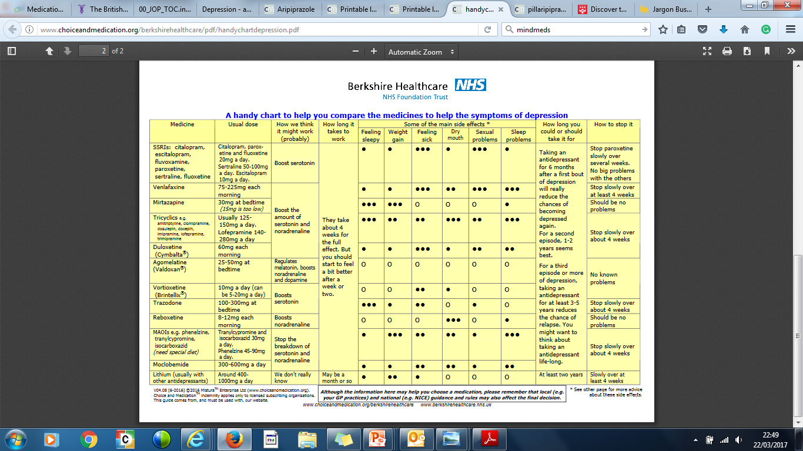

Slide 27
Serotonin Syndrome
Medicines to be cautious with/avoid
Tramadol
Triptans
Other SSRIs, SNRIs
Citalopram – CSM warning
Careful switching – WITH ADVICE
  Cross taper
  Wash out periods
  Stop and start (rarely)

Slide 28
Changing antidepressants
- considerations
Stopping – very carefully and slowly depending on drug half life, patient tolerability and education
Discontinuation symptoms
  Worse with shorter half life drugs – paroxetine, venlafaxine
  Very slowly - at least 4 weeks. Make sure patient is aware

Slide 29
Case Study - Revisited
Mr C, 80 years old gentleman
First hospital admission 2 days ago
Recent history of not sleeping well, getting agitated at night, waking up early in the morning
Stopped cooking for himself about 1 year ago, eats out or take away’s
For last 2 months won’t drive his car
Lost interest in TV programmes, reading the newspaper, current affairs
Now worrying about everything, asked to come into hospital

Slide 30
Mr C’s Medicines O/A
Amitriptyline 20mg at night
Citalopram 10mg at night
Perindopril 2mg in the morning
Metformin 500mg tds
Gliclazide 40mg bd
Diazepam 2mg tds
What would you query and why?

Slide 31
2. Which ONE of the following symptoms is likely to respond early on in the treatment of depression with mirtazapine?
A. sleep
B. anhedonia
C. sexual dysfunction
D. suicidal ideas

Slide 32
3. With respect to NICE guidelines on the pharmacological treatment of depression with medication, which ONE of the following is true?
A. there is more emphasis to start a tricyclic antidepressant as the first-line treatment in a newly diagnosed patient with depression
B. the recommended period of treatment with a drug after initiation before declaring treatment failure is 4-8 weeks
C. an ECG needs to be performed on patients being initiated on any antidepressant for the first time
D. the use of combination treatment is supported and can be considered routine at any given time

Slide 33
4. Which of the following is NOT a common side effect of tricyclic antidepressants (TCA)?
A. dry mouth
B. constipation
C. insomnia
D. postural hypotension

Slide 34
5. Which of the following combinations may result in a clinically significant drug-drug interaction and would need questioning if you saw it on a prescription:
A. amitriptypine + fluoxetine
B. citalopram + haloperidol
C. phenelzine + amitriptyline
D. fluoxetine + venlafaxine
E. clomipramine + moclobemide

Slide 35
6. Which ONE of the following statements about treatment with venlafaxine is TRUE?
A. it is relatively safe in people with cardiovascular disease and requires no monitoring
B. the dose should be reduced in smokers
C. it could be considered in refractory depression used in combination with mirtazapine
D. it is not known to increase suicidal ideation early on in treatment

Slide 36
7. Which of the following statements is TRUE regarding treatment choices for depression?
A. patient choice does not really play a part in the choice of drug when a patient is first diagnosed with a depressive illness
B. the dose of drug should be escalated to the maximum daily licensed dose if the patient is tolerating the side effects
C. overall cost of treatment should be the deciding factor of choice of drug
D. SSRIs are not cardio-toxic in overdose
E. suicide ideation only increases with antidepressant treatment with TCA’s and not with SSRIs

Slide 37
8. Which of the following recommendations from NICE regarding the treatment of depression is correct:
A. SSRIs are the most effective antidepressants
B. SSRIs are a suitable first line treatment choice as they generally better tolerated
C. The lowest acquisition costing drug should be placed as first line treatment within the local drug formulary
D. Mild depression responds well to a combination of a low dose tricyclic antidepressant plus CBT

Slide 38
Thank you!
Questions?
What else can LPFT pharmacy team do to help?

